Slide 1
Variation due to sexual reproduction & mutation

Slide 2
Syllabus:
Variations in genotype of offspring arise as a result of the processes of meiosis, including crossing over & random assortment of chromosomes, and fertilisation, as well as a result of mutations
Explain how sexual reproduction and mutations result in variation in genotype of offspring
Essential Question:

Slide 3
What you need to complete
BIOLOGY WA UNITS 3&4
Chapter 4 Variation and Mutation pg. 91-110
Questions
Set 4.4 pg. 95 Q 1-5
Set 4.5 pg. 97 Q 1-5
Set 4.6a pg. 100 Q 1-4
Set 4.6b pg. 107 Q 1-8
Set 4.7 pg. 110 Q 1-5
BIOZONE
Activity Number: 166, 170, 172, 175, 176, 177, 178,

Slide 4
Topic Question 1: What are the main mechanisms for genotypic and phenotypic variation?
Phenotypic expression of genes
Sources of variation
Mutation
Gene mutations and chromosome mutations
Sexual reproduction processes
Independent (random) assortment, crossing over, random mating/fertilisation
Change in genotype
Environmental factors
Internal (e.g. presence or absence of hormones) and external environmental factors (e.g. temperature and light intensity)
Epigenetics
Chemicals that can switch genes on or off (only changes phenotypes, not genotypes)
Change in phenotype

Slide 5
Topic Question 2: Describe how sexual reproduction increases to genetic variation
Random fertilisation/mating
Crossing Over
Sexual reproduction
Meiosis
Random Assortment

Slide 6
Topic Question 3: Genetic Variation is a prerequisite for evolution. Mutation is one source of genetic variation and meiosis is another. Name and describe the two ways in which meiosis produces genetic variation (10 marks)
Quick Write
1. Answer the question above. It is worth 10 marks, so you have 10 mins

Slide 7
Random/independent assortment (1 mark)
Any four of the following – 1 mark each (max 4 marks)
During metaphase I/during reduction division
Chromosomes align in the centre of the cell
Chromosomes then move/segregate to different poles
Recognition that the alignment of the chromosomes is random/separation of the chromosomes to different poles is random with respect to parent origin
Recognition that homologous chromosomes separate
Gametes contain a mix of chromosomes from each ‘parent’ resulting in genetic variation
Crossing Over (1 mark)
Any four of the following – 1 mark each (max 4 marks)
Occurs in the early stages pf meiosis/prophase I/during the reduction division
Homologous chromosomes pair/synapse
They then exchange/swap sections of DNA
Recognition that the process involves homologous chromosomes/homologous sequence exchange (must mention the work homologous)
This creates chromosomes with new combinations of alleles/genes – resulting in genetic variation

Slide 8
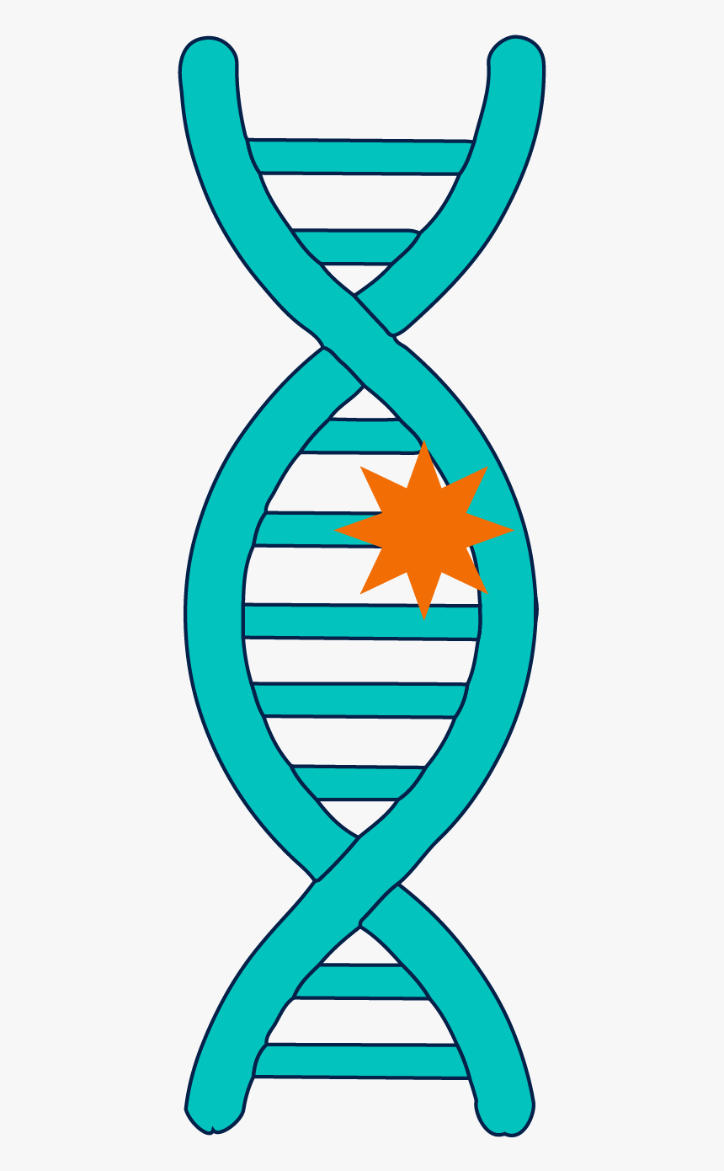
Topic Question 4: Mutation is said to be the ultimate source of variation. Explain what is meant by this statement
It’s the only process that can do this!!!
A mutation is a permanent changes to the structure of the DNA of an organism
Mutations result in new genetic material, new alleles
Can result from errors in DNA replication or cell division, or from environmental factors which can lead to change in DNA sequence or chromosome number
In multicellular organisms, mutations can be classified as somatic or germ-line mutations

Slide 9
Topic Question 5: State the difference between a somatic and a germline mutation
Somatic mutations – occur in a single body cell & cannot be inherited. Only tissue derived from mutated cell are affected
Germline mutations – occur in gametes & can be passes onto offspring. Every cell in the organism will be affected

Slide 10
Topic Question 6: Discuss the consequences of a mutation occurring in a germline cell and in a somatic cell
Consequence of Somatic Mutations
Not inherited as not in gamete
Does not usually affect health or fertility because the mutation is limited to a particular cell line
Unless….
causes cancer
Or happens early in embryonic development resulting in all cells carrying the mutation

Slide 11
Topic Question 6: Discuss the consequences of a mutation occurring in a germline cell and in a somatic cell
Consequence of Germline Mutations
Don’t usually affect health of the individual that underwent the mutation
Can be passed onto offspring
The offspring’s health/fertility can be affected as all their cells will carry the mutation

Slide 12
Topic Question 7: What are the causes of mutations
Cell division
Chromosome mutations
Replication Errors
Gene mutations
Causes of mutation
physical
Mutagens
chemical
Biological

Slide 13
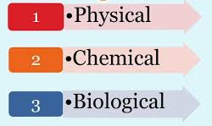
Topic Question 8: Define the term mutagen
Mutagen – an environmental factor that causes a change in the structure of DNA
Increase the mutation rate

Slide 14
Topic Question 9: Explain, including examples, how physical mutagens in the environment can cause mutations
Physical Mutagens:
All produce energy that damages/changes the structure of DNA
Radiation, Ultra violet light, nuclear radiation.
Example:
Ultra Violet light causes adjacent bases in DNA to bind together
Radiation contains energy that damages DNA, altering the structure of DNA

Slide 15
Topic Question 9: Explain, including examples, how chemical mutagens in the environment can cause mutations
Chemical Mutagens:
A chemical in the environment that reacts with DNA
Alcohol, Smoke, mustard gas.
These may substitute a base or add/remove bases or change the chemical properties of DNA.
Exact affect depends on the chemical
Example: mustard gas causes guanine in DNA to be replaced by other bases

Slide 16
Topic Question 9: Explain, including examples, how biological mutagens in the environment can cause mutations
Biological Mutagens:
Virus, bacteria, microorganisms that infect cells, causing damage/change to the DNA of the cell
Example: some bacteria produce toxins that damage DNA. A virus can damage DNA when they insert their genome into the DNA of the cell

Slide 17
Homework Activity
Complete Biozone 166, 170 and 172
Read pages 97 – 100
Answer Topic Questions 10, 11 & 12

Slide 18
Topic Question 10: What is a gene mutation?

Slide 19
Topic Question 11: Describe the three types of point mutations

Slide 20
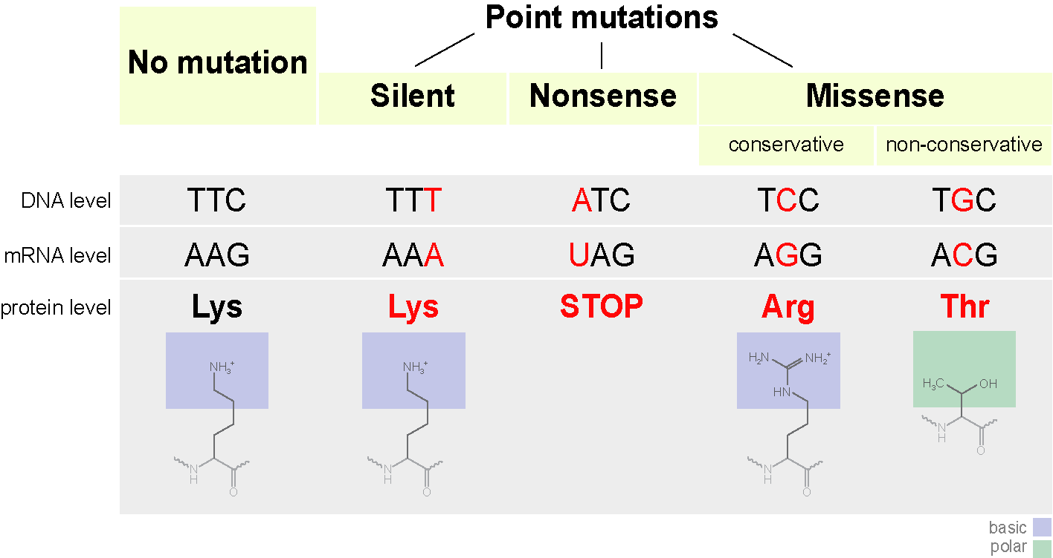
Topic Question 12: Describe the possible effects of a substitution mutation
Synonymous or silent mutation
Nonsense mutation
Missense mutation

Slide 21
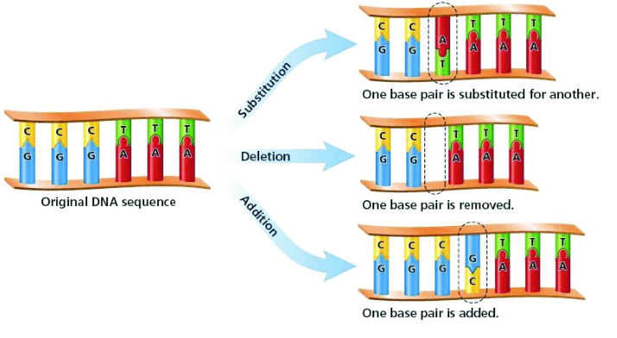
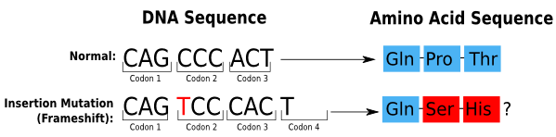
Topic Question 13: Describe the possible effects of a deletion or insertion mutation
The Deletion or insertion of a nucleotide can change the which bases are read together
Insertions & Deletions are classified as frameshift mutations

Slide 22
Topic Question 14: Describe the possible effects of a deletion or insertion mutation if the mutated DNA sequence is transcribed in mRNA
What would occur if the deletion or insertion occurred on an intron?
What is the deletion or insertion occurred on an exon?

Slide 23
Topic Question 15: What are Chromosome mutations
Chromosome mutations result from errors during cell division
Can include change to chromosome number and can be viewed using a karyotype
Or change to chromosome structure

Slide 24
Topic Question 16: Describe the terms monoploidy, aneuploidy and polyploidy
Read pages 102 – 104 and complete Biozone 175, 177 and 178 to answer

Slide 25
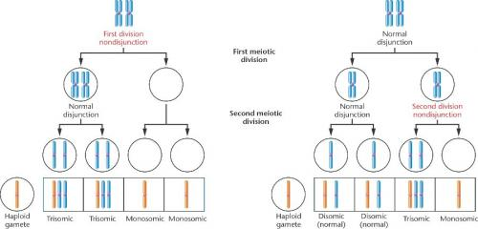
Topic Question 17: Describe non-disjunction and how it can lead to aneuploidy or polyploidy

Slide 26
Topic Question 18: Describe how Genetic variation can be caused by changes to chromosome structure

Slide 27
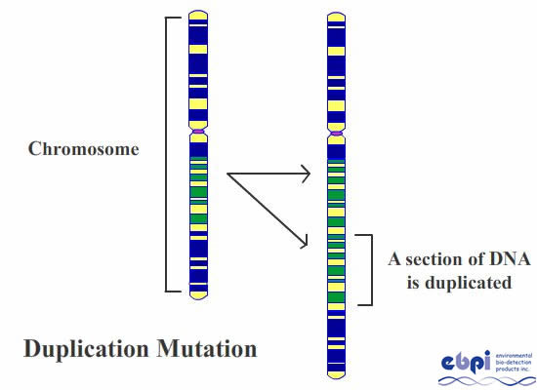
Topic Question 18: Describe how Genetic variation can be caused by changes to chromosome structure
Duplication
Extra copy is made of a section of chromosome & inserted either into the same chromosome or another chromosome
Change the number of copies of particular genes

Slide 28
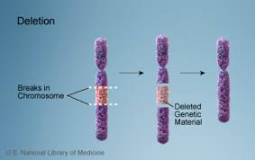
Topic Question 18: Describe how Genetic variation can be caused by changes to chromosome structure
Deletion
Chromosome may undergo double-stranded breaks at two positions & the section between may drop out, removing all its genes with it

Slide 29
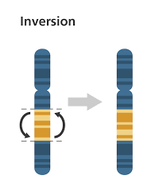
Topic Question 18: Describe how Genetic variation can be caused by changes to chromosome structure
Inversion
Chromosome breaks in 2 places & the segment in the middle rotates 180 degrees before being re-joined with the chromosome
Reverses the normal sequence of genes
Usually less dramatic that other types of chromosome mutations as genes are not lost or gained & the genes within the inverted segment can still function normally

Slide 30
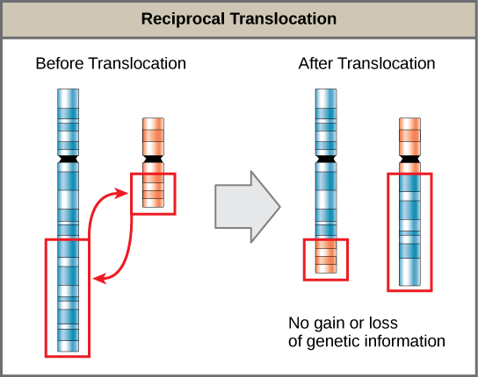
Topic Question 18: Describe how Genetic variation can be caused by changes to chromosome structure
Translocations
When a section of one chromosome breaks off & re-attaches to another chromosome
Example: in humans when a segment of chromosome 8 ends up with chromosome 14 or vise versa, the normal control over the genes in that sequence is lost, resulting in a form of cancer

Slide 31
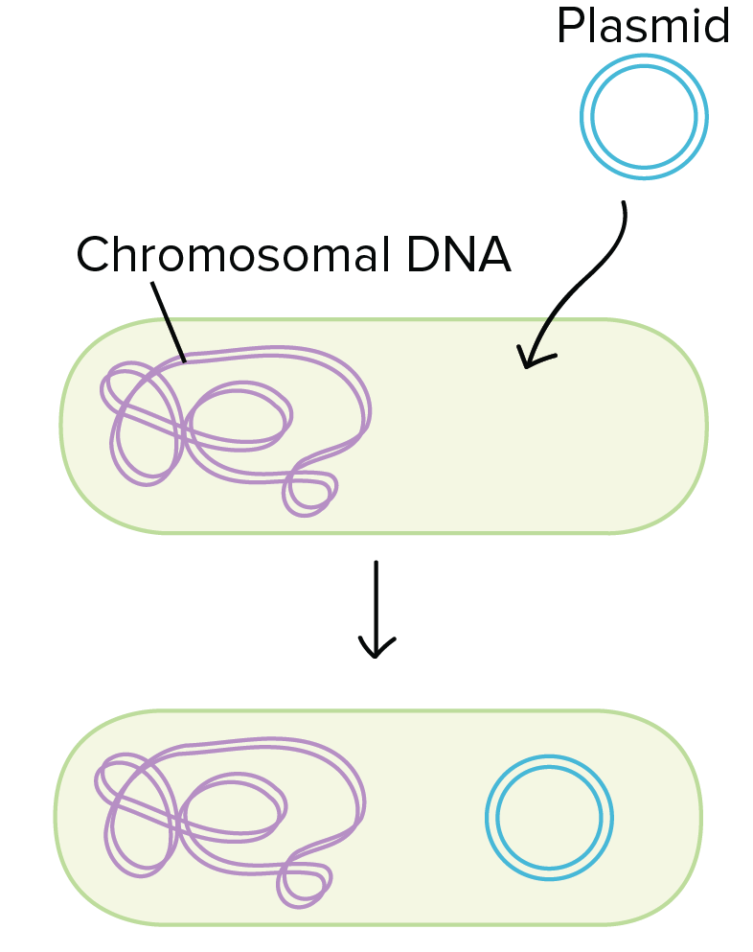
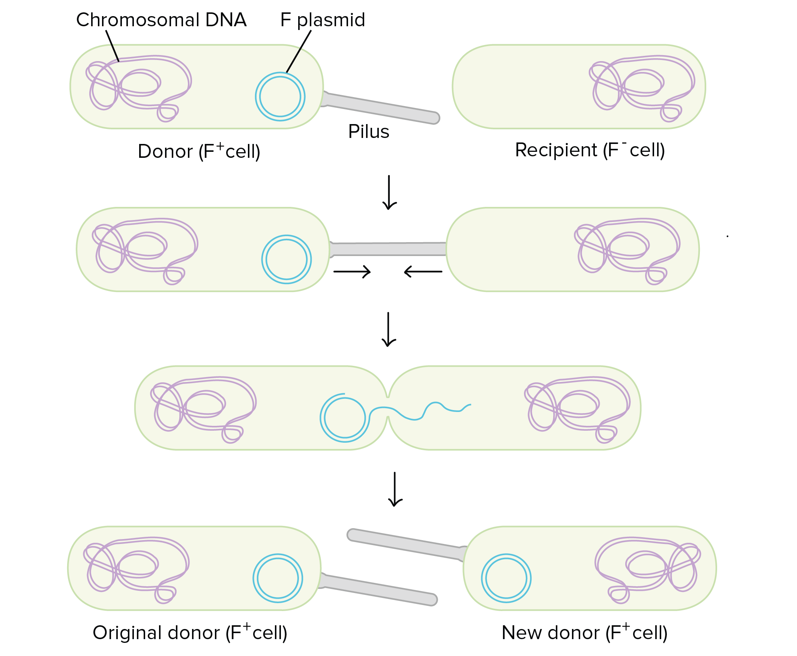
Topic Question 19: Describe how genetic variation can occur in asexually reproducing prokaryotes
Mutation
Transformation - a bacterium takes in DNA from its environment, often DNA that's been shed by other bacteria. If the DNA is in the form of a circular DNA called a plasmid, it can be copied in the receiving cell and passed on to its descendants.
Conjunction - DNA is transferred from one bacterium to another. After the donor cell pulls itself close to the recipient using a structure called a pilus, DNA is transferred between cells. In most cases, this DNA is in the form of a plasmid.
https://www.khanacademy.org/science/ap-biology/gene-expression-and-regulation/mutations-ap/a/genetic-variation-in-prokaryotes

